Slide 1

Land Type Classification using Sentinel-2 / NWPU-RESISC45

Slide 2

Land Type Classification using Sentinel-2 / NWPU-RESISC45
Deep Learning Pipeline with ResNet50 & EfficientNetB0
This presentation details our advanced deep learning pipeline designed for precise land type classification using high-resolution satellite imagery. We leverage the Sentinel-2 dataset, processed through the NWPU-RESISC45 benchmark, to develop robust models for critical real-world applications. Our approach focuses on optimizing model performance and providing actionable insights.

Slide 3


Critical Applications of Land Cover Classification
Agriculture Monitoring
Track crop health, yields, and seasonal changes to support global food security planning and resource allocation.
Water Resource Management
Identify crucial water bodies, wetlands, and watersheds to support conservation efforts and monitor drought conditions.
Urban Planning
Monitor urban sprawl, infrastructure development, and land use patterns to enable sustainable city growth and development.
Environmental Studies
Assess critical environmental issues such as deforestation, biodiversity loss, and the widespread impacts of climate change.

Slide 4

The Classification Challenge: 45 Distinct Land Types
The primary challenge lies in accurately distinguishing over 45 distinct land types from high-resolution satellite imagery. This requires sophisticated automated deep learning approaches capable of discerning subtle visual differences across a wide range of categories.

Slide 5
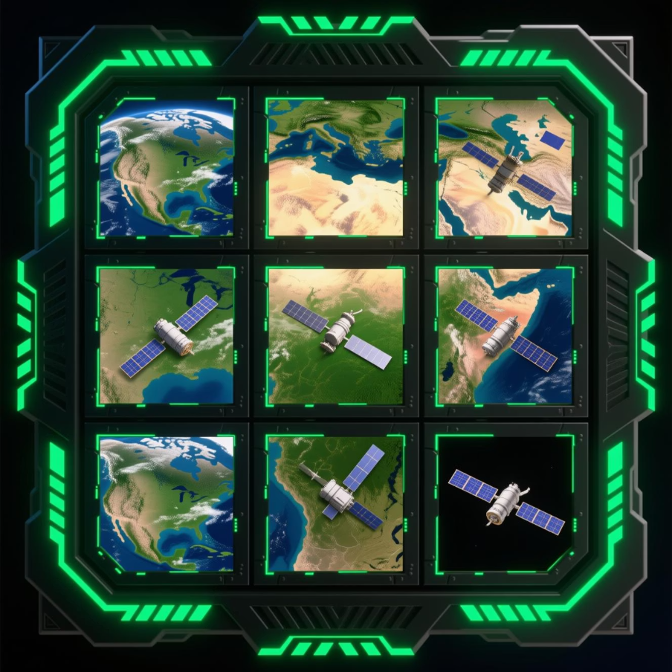
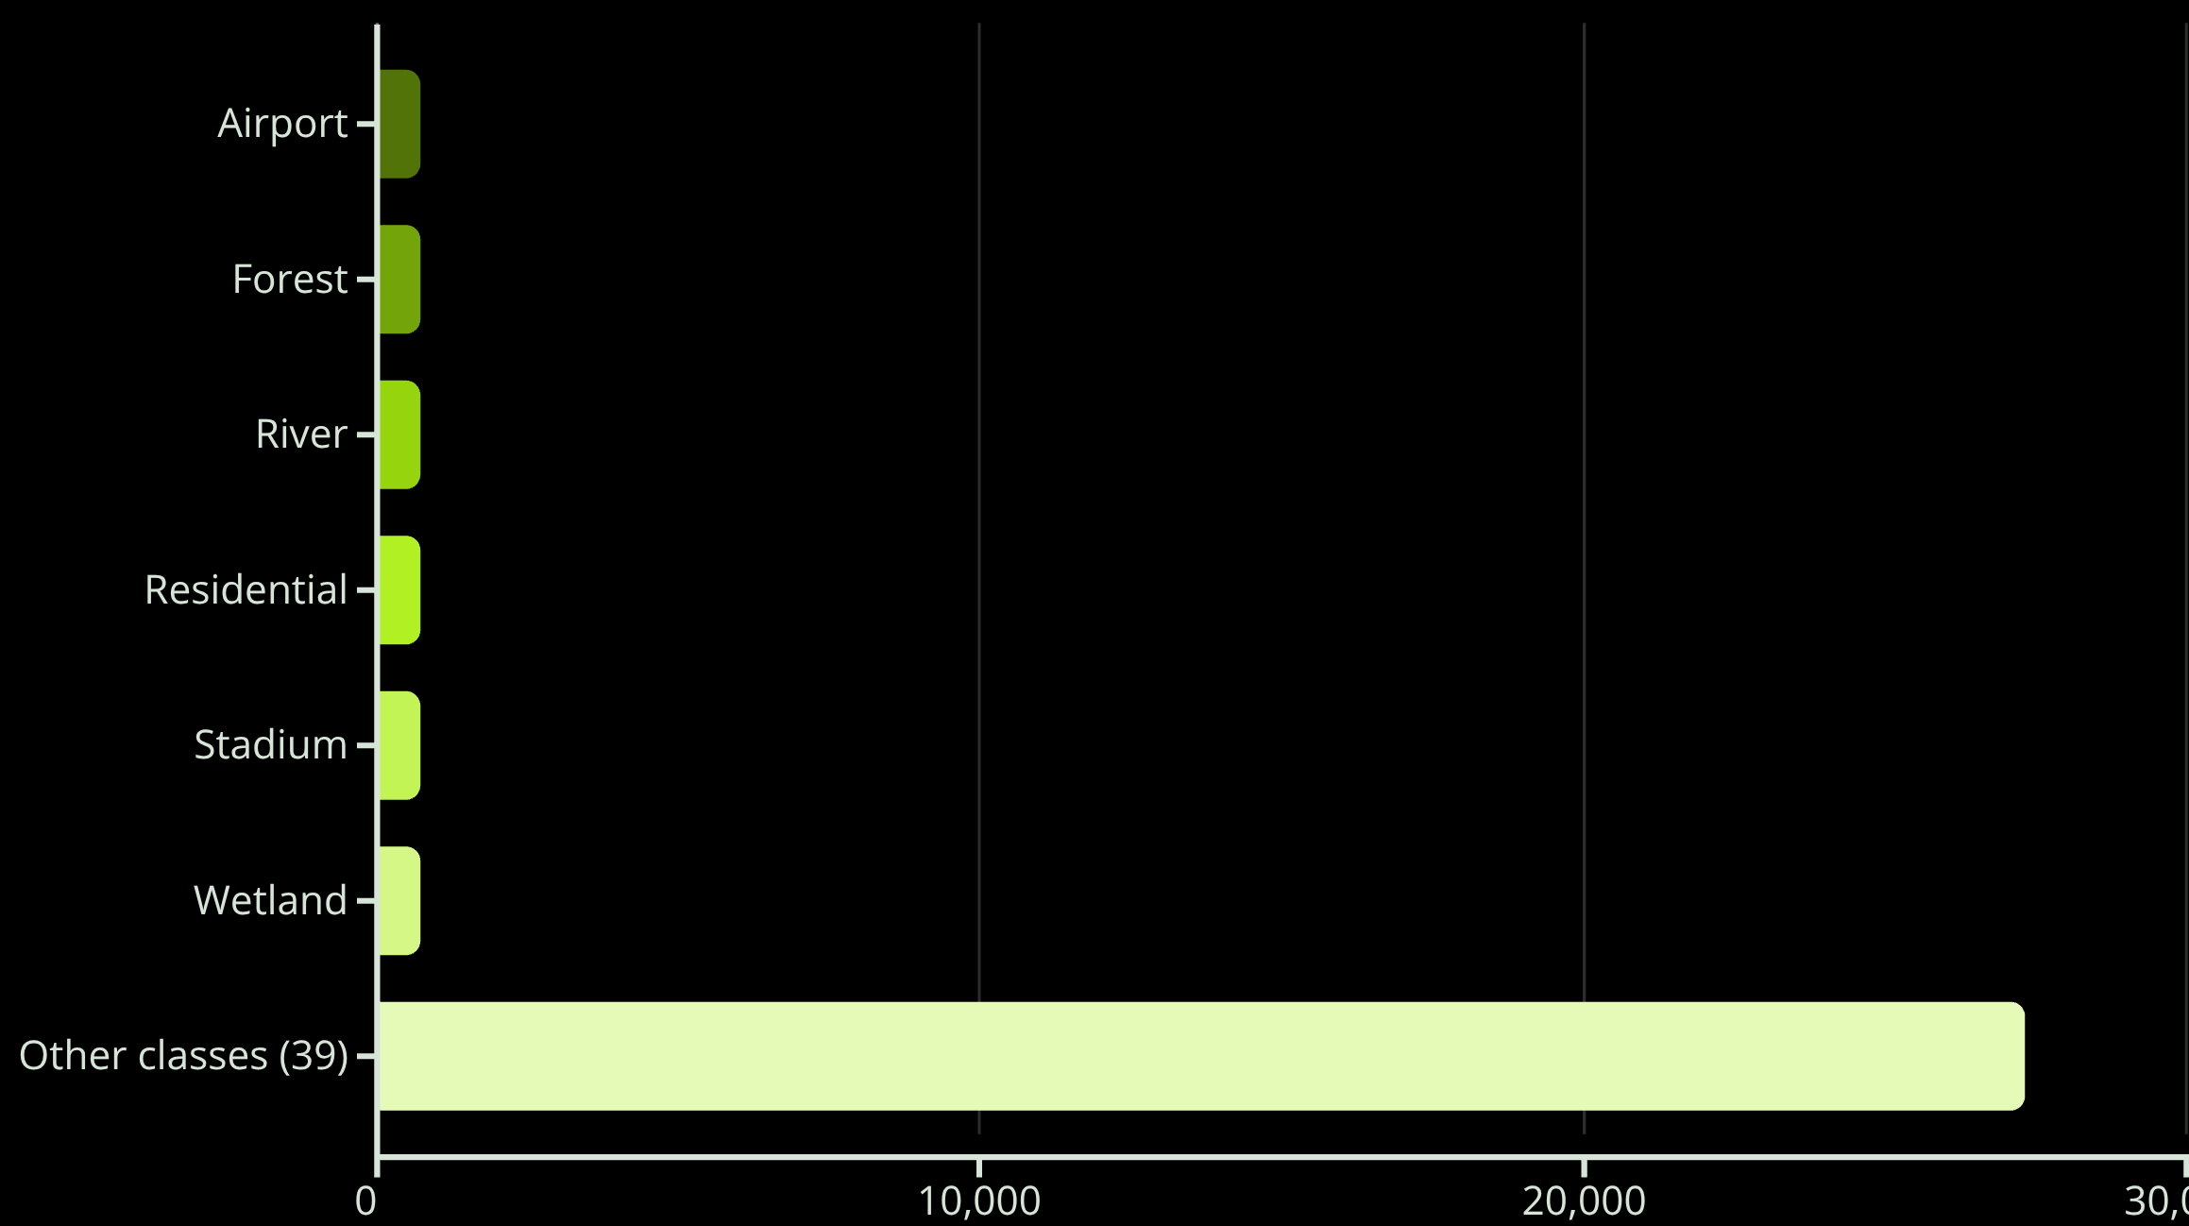
Dataset Overview: NWPU-RESISC45
The NWPU-RESISC45 dataset is a cornerstone of this project, offering a comprehensive collection for remote sensing image classification.
31,500 high-resolution images
45 distinct land cover classes
Approximately 700 images per class, ensuring balanced distribution
Standardized resolution: 224×224 pixels
Captures RGB color channels, sourced from Sentinel-2 satellite data
The dataset's uniform image count per class is critical for preventing bias and ensuring robust model training.

Slide 6
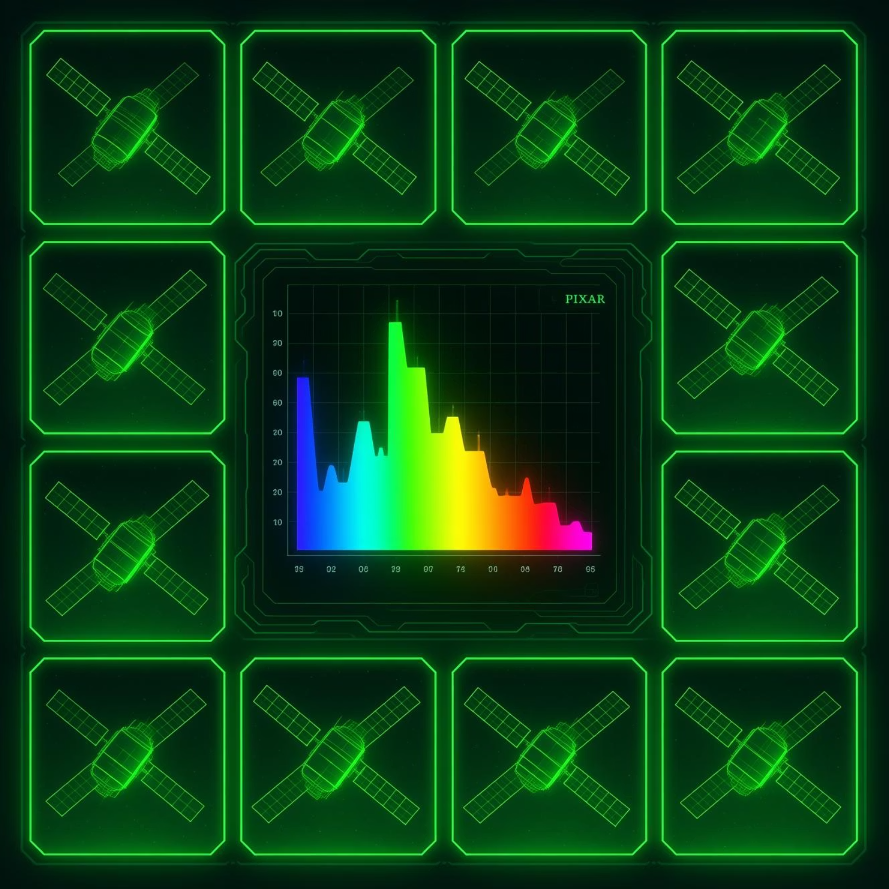
Exploratory Data Analysis (EDA) Insights
Our EDA revealed key characteristics ensuring optimal model performance:
Balanced Class Distribution: Each of the 45 classes contains approximately 700 images, crucial for unbiased model training and preventing overfitting to dominant classes.
Standardized Imagery: All images are consistently resized to 224×224 pixels and normalized across RGB color channels, ensuring uniform input for our deep learning models.
Comprehensive Analysis: The EDA Notebook includes detailed color histogram analysis, interactive sample image grids, and clear class distribution visualizations to thoroughly understand the dataset's properties.
These insights confirm the dataset's suitability for developing high-accuracy land type classification models.

Slide 7
Model Performance: ResNet50 vs. EfficientNetB0
We conducted a rigorous comparison between two leading deep learning architectures to determine the most effective solution for our classification task.
Model
Validation Accuracy
Notes
ResNet50
81.9%
Strong baseline, robust foundational performance
EfficientNetB0
96.3%
Significantly improved accuracy through advanced optimization
Performance Gain: A substantial 14.4% increase in validation accuracy was achieved with EfficientNetB0, demonstrating its superior capability.
Optimization Techniques
AdamW optimizer for efficient gradient descent
Cosine annealing learning rate schedule
Early stopping regularization to prevent overfitting
Advanced data augmentation: Flip, Rotation, MixUp, CutMix

Slide 8



Interactive Streamlit Application
Our interactive Streamlit application provides a user-friendly interface for real-time land type classification.
Image Upload: Intuitive drag-and-drop interface for seamless input of satellite imagery.
Model Inference: Utilizes the optimized EfficientNetB0 model for rapid, real-time predictions.
Land Type Prediction: Displays probability scores for all 45 land classes, offering clear and actionable insights.
This application empowers users to quickly analyze satellite images and obtain precise land type classifications.
Model Inference
Land Type Prediction
Image Upload

Slide 9


Enhanced Features & Historical Data Management
Image Processing Enhancements
Historical Data Management
Preprocessing: Automated adjustments for sharpness, brightness, and contrast.
Comprehensive Tools: Save, Edit, Delete, Search, and Filter functionalities for historical predictions.
Upscaling: Enhances image resolution for clearer analysis.
Export Options: Easily export data to Excel for further analysis and reporting.
Comparison View: Side-by-side display of original vs. enhanced imagery.
Interactive Dashboard: Visualize historical data with dynamic plots and integrated maps for trend analysis.
Video Integration: Extracts individual frames from videos for sequential prediction.

Slide 10





Recommendations Engine
Our integrated recommendations engine translates classification results into actionable insights, guiding users towards optimal land utilization and planning.
Coordinates Input
User provides specific geographical coordinates for analysis.
Image Retrieval
System retrieves corresponding satellite imagery for the specified location.
Predicted Land Type
EfficientNetB0 model classifies the land type with high accuracy.
Suggested Uses
Rule-based engine provides 3–5 tailored land suitability recommendations.
This engine provides rule-based land suitability recommendations, offering 3–5 precise suggestions per land type. It's fully integrated across all prediction pages, ensuring a seamless user experience from input to actionable guidance.

